Slide 1
Hotel Website
Team # 2 Cam & Matt

Slide 2



Team
Matt Sabadac Cameron Bentz

Slide 3
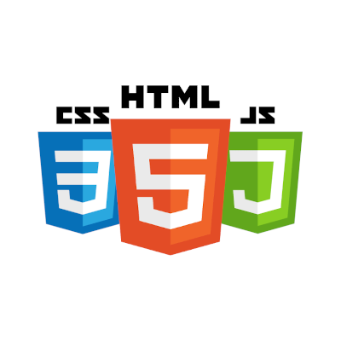
Problem
Our team is working on developing a web application for the Matt and Cameron Hotel, an innovative solution for a group of hotels, headquartered in downtown Flint, MI. Because a venture round is just around the corner, with a tight deadline, our group needs to rapidly develop the hotel website. Using CSS, HTML & JavaScript, we intend to deliver our project as expected.

Slide 4

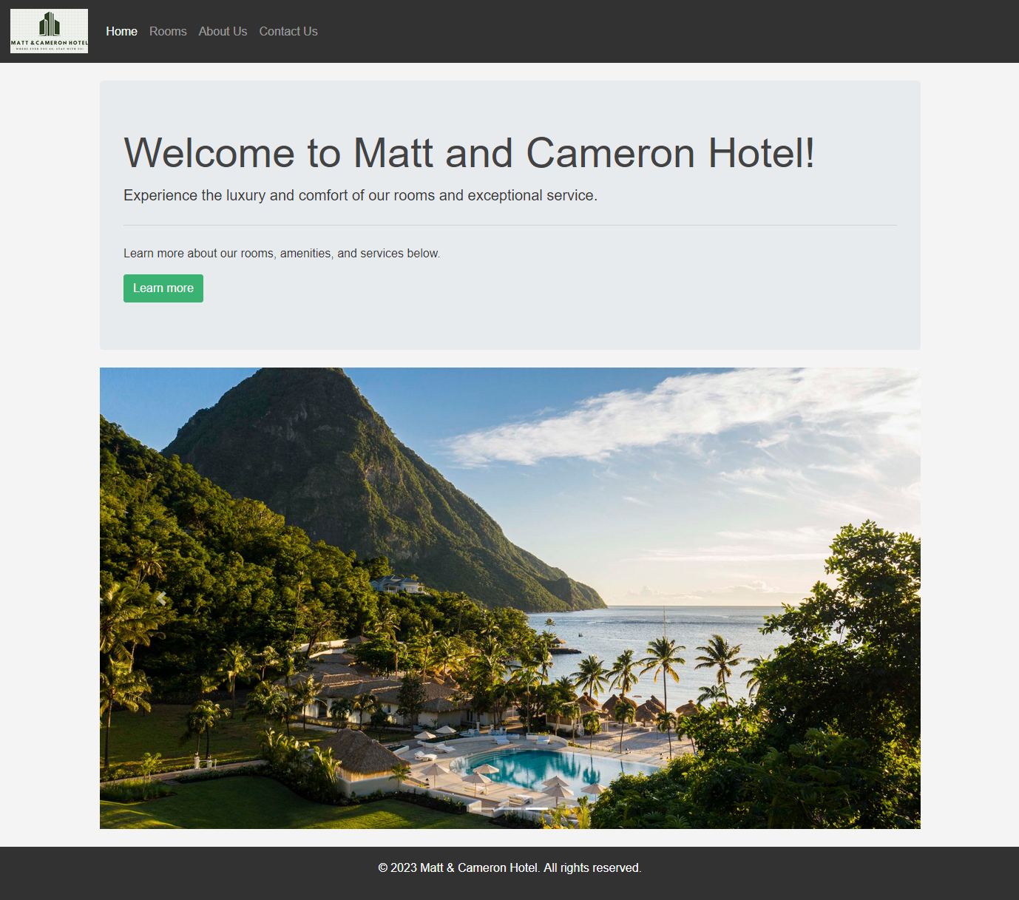
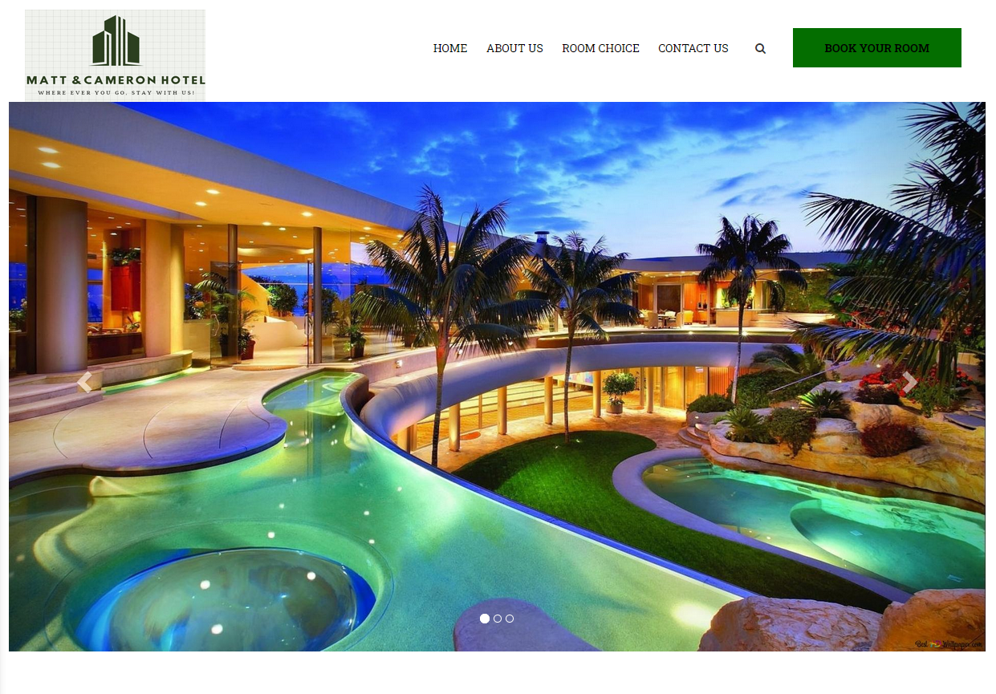
The Front End
Our website consists of four HTML pages and a single CSS file.

Slide 5
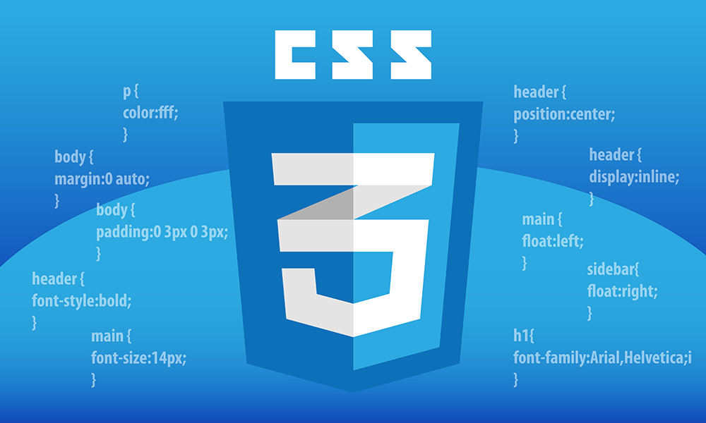
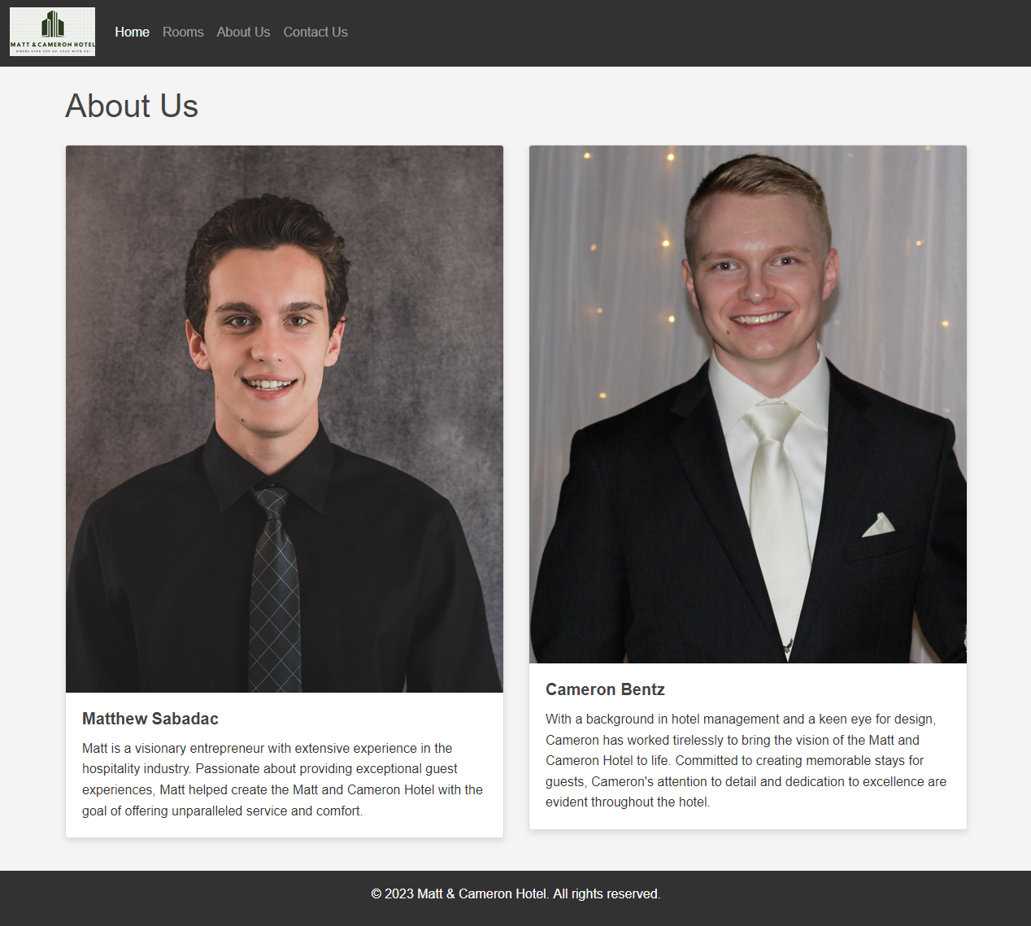
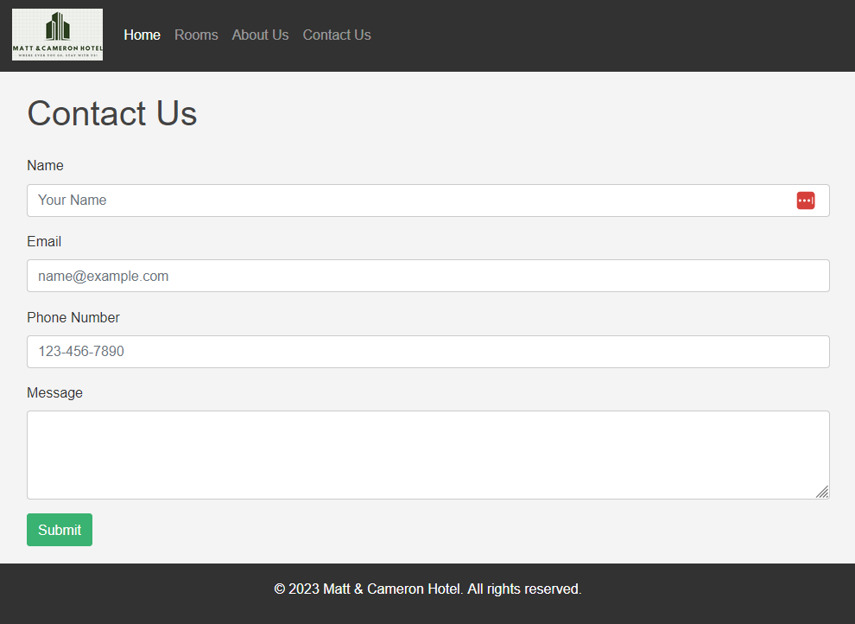
More Front End

Slide 6
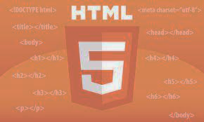
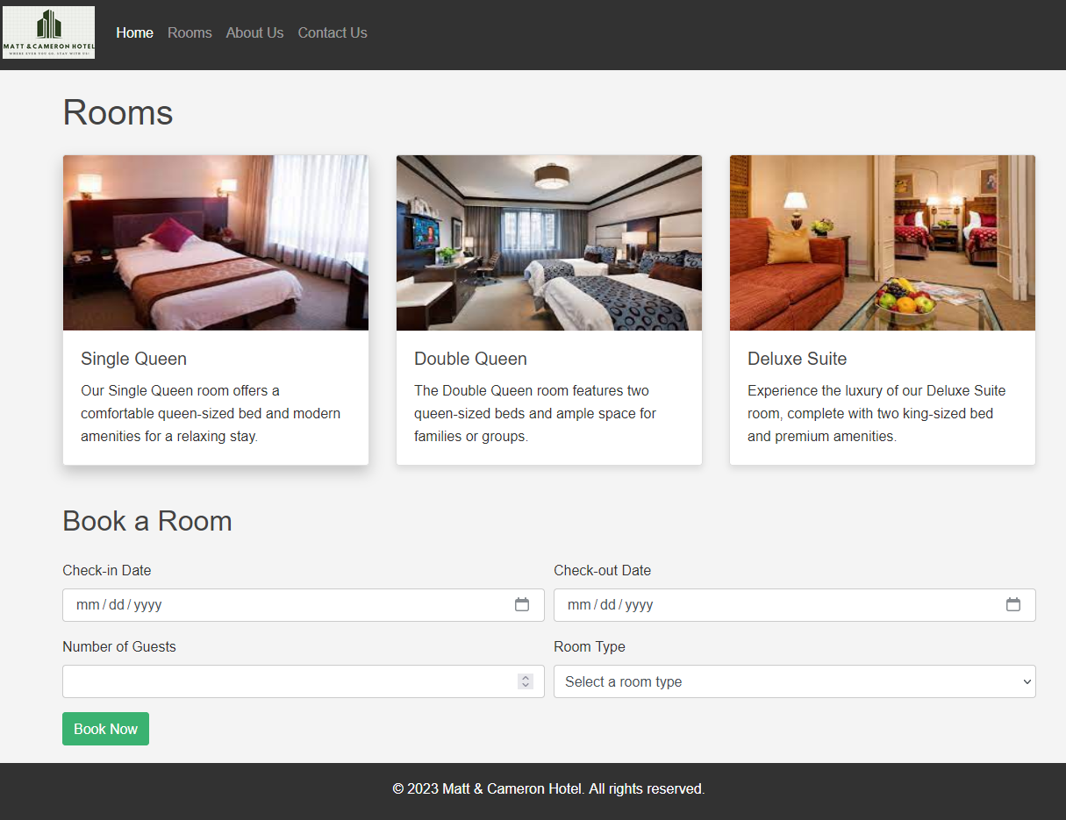
Even More Front End
Bootstrap Elements:
Navbar
Carousel
Cards
Forms
Jumbotron

Slide 7
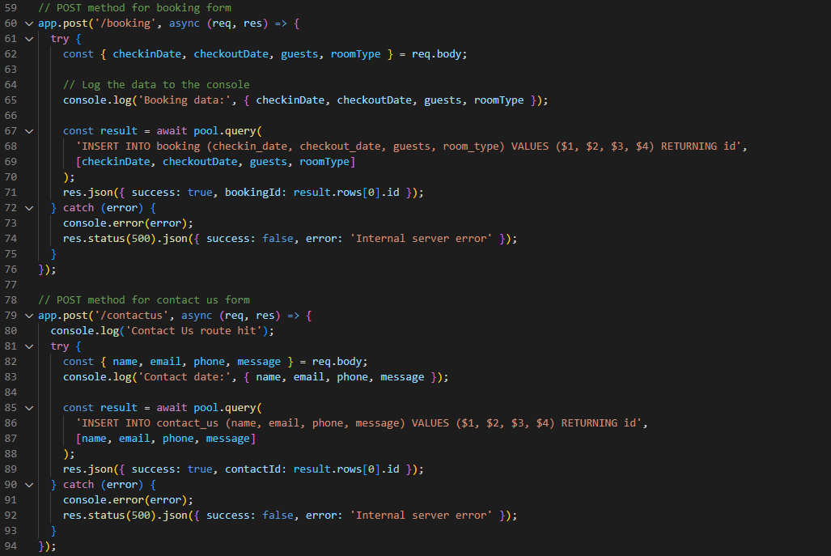
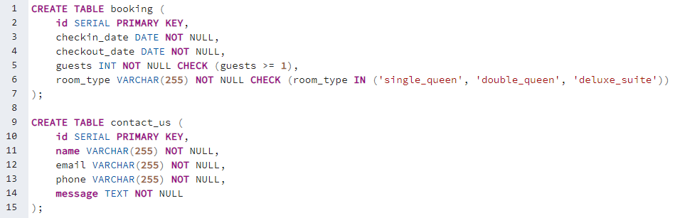
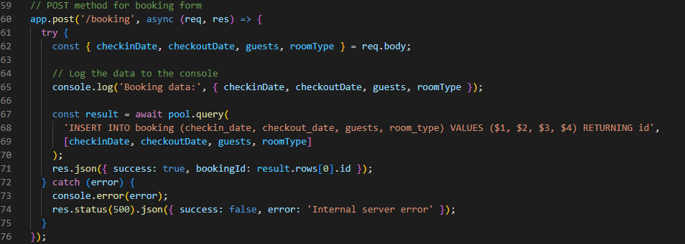
The Back End
Using AJAX, jQuery, JSON, and PostgreSQL, data is sent to and from the backend.

Slide 8

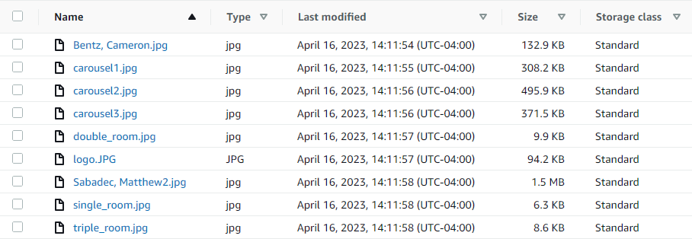
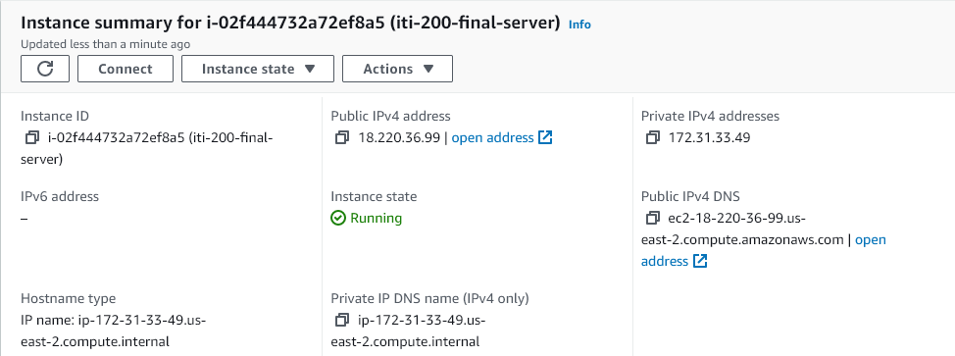
Solutions
Our website is fully hosted in the cloud using the following Amazon Web Services: - S3 Bucket (for images) - RDS (database) - EC2 (cloud server)

Slide 9
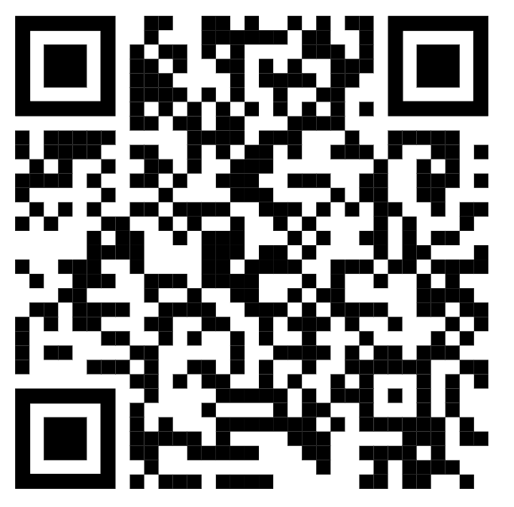
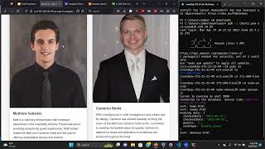
Demo of the hotel website.
Visit at: http://ec2-18-220-36-99.us-east-2.compute.amazonaws.com:3000
Source code: https://github.com/RusskiyMedved/ITI-200-Final

Slide 10

Lessons Learned
Developing the hotel webpage our group was able to practice and have hands-on experience on all the concepts studied throughout the entire semester. The concepts applied are: HTML, CSS, and JavaScript, along with the widely used frameworks for CSS and JavaScript, such as Bootstrap, jQuery, and node.js. The important lesson learned was to work as a team and to exchange ideas and focus on ideas completing the project.

Slide 11

Issues & Bugs Known
Unlimited guests can stay in any room.
Past dates can be selected for check-in.
Navbar does not update with active page.
Invalid emails can be entered on the contact form.

Slide 12

Future Versions
Enhance bootstrap elements to be more visually appealing and professional (update navbar active page).
Place limits on number of guests on a per-room basis.
Create employee login page to view active bookings and contact requests.

Slide 13
References
“Introduction to HTML - Learn Web Development: MDN.” Learn Web Development | MDN, https://developer.mozilla.org/en-US/docs/Learn/HTML/Introduction_to_HTML.
JQuery Tutorial, https://www.w3schools.com/jquery/default.asp.
Mark Otto, Jacob Thornton. “Get Started with Bootstrap.” · Bootstrap v5.2, https://getbootstrap.com/docs/5.2/getting-started/introduction/.
Mark Otto, Jacob Thornton. “Typography.” · Bootstrap v5.2, https://getbootstrap.com/docs/5.2/content/typography/.

Slide 14
Thank you!
Any questions?

